Slide 1
Lecture: Recursion

Slide 2
Overview
Recursion
An algorithmic puzzle using recursion
Examples of basic recursion
Examples of array recursion
Examples of Linked lists recursion

Slide 3
What is Recursion
Sometimes, the best way to solve a problem is by solving a smaller version of the exact same problem first
Recursion is a technique that solves a problem by solving a smaller problem of the same type
In mathematics and computer science, recursion is a method of defining functions in which the function being defined is applied within its own definition
Recursion is much more readable, but consumes more memory (uses recursive call stack)
Iterative is not readable, but does not consume more memory (Does not use any stack)
Recursion

Slide 4


Cake Eating Problem
The cake is too huge to fit in your mouth — you can’t eat it all at once.

Slide 5
Cake Eating Problem
The cake is too huge to fit in your mouth — you can’t eat it all at once.
To finish it, you must cut it into smaller, manageable pieces first
  — same structure, same taste.

Slide 6
Cake Eating Problem
Problem: The cake is too large to eat in one go.
Recursive Approach:
Slice the cake into a smaller piece → repeat on the smaller piece. (Recursive Step/Case)
When the slice is bite-sized,
just eat it — no more slicing needed. (Base Case)
Insight: Each slice is a smaller version of the same cake —same structure, same taste — perfect for recursion.

Slide 7
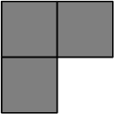
Tromino cover
Tromino cover: A right tromino is an L-shaped tile formed by three adjacent squares.
Figure: Rezaul A. Chowdhury, CSE 373, 2014
An algorithmic puzzle

Slide 8
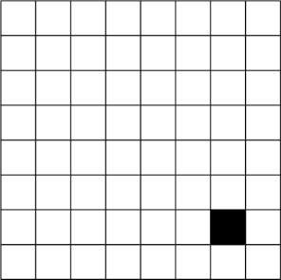
Tromino cover
Puzzle: You are given a 2^{n} ×2^{n} board
with one missing square.
you must cover all squares except the missing one exactly using right number of trominoes
the trominoes must not overlap
Figure: Rezaul A. Chowdhury, CSE 373, 2014
An algorithmic puzzle

Slide 9
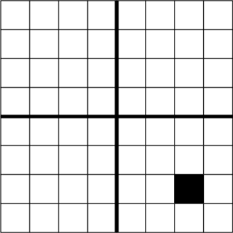
Tromino cover
Steps:
Divide the 2^{n} × 2^{n} board into 4 disjoint 2^{n−1} × 2^{n−1} subboards
Figure: Rezaul A. Chowdhury, CSE 373, 2014
An algorithmic puzzle

Slide 10
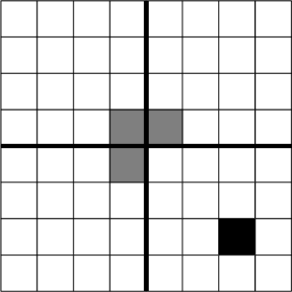
Tromino cover
Steps:
Divide the 2^{n} × 2^{n} board into 4
disjoint 2^{n−1} × 2^{n−1} subboards
Place a tromino at the center so that it fully covers one square from each of the three ( 3 ) subboards with no missing square, and misses the fourth subboard completely. This reduces the original problem into 4 smaller instances of the same problem!
Figure: Rezaul A. Chowdhury, CSE 373, 2014
An algorithmic puzzle

Slide 11
Tromino cover
Steps:
Divide the 2^{n} × 2^{n} board into 4 disjoint 2^{n−1} × 2^{n−1} subboards
Place a tromino at the center so that it fully covers one square from each of the three ( 3 ) subboards with no missing square, and misses the fourth subboard completely. This reduces the original problem into 4 smaller instances of the same problem!
Solve each smaller subproblem recursively using the same technique.
Figure: Rezaul A. Chowdhury, CSE 373, 2014
An algorithmic puzzle

Slide 12
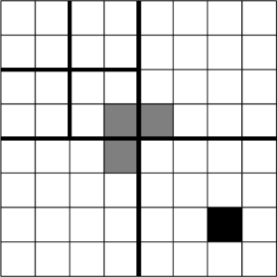
Tromino cover
Steps:
Divide the 2^{n} × 2^{n} board into 4 disjoint 2^{n−1} × 2^{n−1} subboards
Place a tromino at the center so that it fully covers one square from each of the three ( 3 ) subboards with no missing square, and misses the fourth subboard completely. This reduces the original problem into 4 smaller instances of the same problem!
Solve each smaller subproblem recursively using the same technique.
An algorithmic puzzle
Figure: Rezaul A. Chowdhury, CSE 373, 2014
8/44

Slide 13
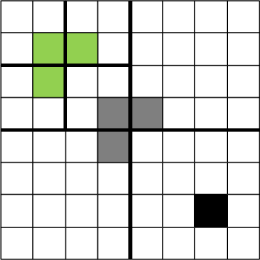
Tromino cover
Steps:
Divide the 2^{n} × 2^{n} board into 4 disjoint 2^{n−1} × 2^{n−1} subboards
Place a tromino at the center so that it fully covers one square from each of the three ( 3 ) subboards with no missing square, and misses the fourth subboard completely. This reduces the original problem into 4 smaller instances of the same problem!
Solve each smaller subproblem recursively using the same technique.
An algorithmic puzzle
Figure: Rezaul A. Chowdhury, CSE 373, 2014
9/44

Slide 14
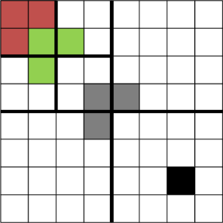
Tromino cover
Steps:
Divide the 2^{n} × 2^{n} board into 4 disjoint 2^{n−1} × 2^{n−1} subboards
Place a tromino at the center so that it fully covers one square from each of the three ( 3 ) subboards with no missing square, and misses the fourth subboard completely. This reduces the original problem into 4 smaller instances of the same problem!
Solve each smaller subproblem recursively using the same technique.
An algorithmic puzzle
Figure: Rezaul A. Chowdhury, CSE 373, 2014
10/44

Slide 15
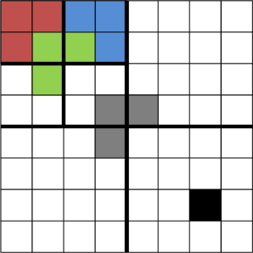
Tromino cover
Steps:
Divide the 2^{n} × 2^{n} board into 4 disjoint 2^{n−1} × 2^{n−1} subboards
Place a tromino at the center so that it fully covers one square from each of the three ( 3 ) subboards with no missing square, and misses the fourth subboard completely. This reduces the original problem into 4 smaller instances of the same problem!
Solve each smaller subproblem recursively using the same technique.
An algorithmic puzzle
Figure: Rezaul A. Chowdhury, CSE 373, 2014
11/44

Slide 16
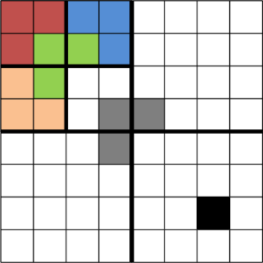
Tromino cover
Steps:
Divide the 2^{n} × 2^{n} board into 4 disjoint 2^{n−1} × 2^{n−1} subboards
Place a tromino at the center so that it fully covers one square from each of the three ( 3 ) subboards with no missing square, and misses the fourth subboard completely. This reduces the original problem into 4 smaller instances of the same problem!
Solve each smaller subproblem recursively using the same technique.
An algorithmic puzzle
Figure: Rezaul A. Chowdhury, CSE 373, 2014
12/44

Slide 17
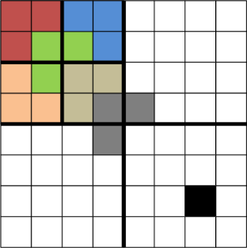
Tromino cover
Steps:
Divide the 2^{n} × 2^{n} board into 4 disjoint 2^{n−1} × 2^{n−1} subboards
Place a tromino at the center so that it fully covers one square from each of the three ( 3 ) subboards with no missing square, and misses the fourth subboard completely. This reduces the original problem into 4 smaller instances of the same problem!
Solve each smaller subproblem recursively using the same technique.
An algorithmic puzzle
Figure: Rezaul A. Chowdhury, CSE 373, 2014
13/44

Slide 18
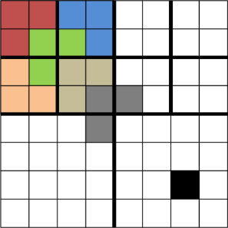
Tromino cover
Steps:
Divide the 2^{n} × 2^{n} board into 4 disjoint 2^{n−1} × 2^{n−1} subboards
Place a tromino at the center so that it fully covers one square from each of the three ( 3 ) subboards with no missing square, and misses the fourth subboard completely. This reduces the original problem into 4 smaller instances of the same problem!
Solve each smaller subproblem recursively using the same technique.
An algorithmic puzzle
Figure: Rezaul A. Chowdhury, CSE 373, 2014
14/44

Slide 19
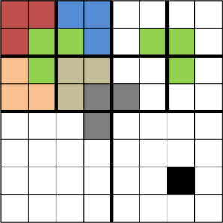
Tromino cover
Steps:
Divide the 2^{n} × 2^{n} board into 4 disjoint 2^{n−1} × 2^{n−1} subboards
Place a tromino at the center so that it fully covers one square from each of the three ( 3 ) subboards with no missing square, and misses the fourth subboard completely. This reduces the original problem into 4 smaller instances of the same problem!
Solve each smaller subproblem recursively using the same technique.
An algorithmic puzzle
Figure: Rezaul A. Chowdhury, CSE 373, 2014
15/44

Slide 20
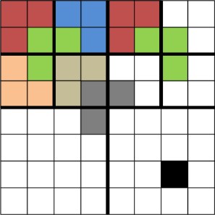
Tromino cover
Steps:
Divide the 2^{n} × 2^{n} board into 4 disjoint 2^{n−1} × 2^{n−1} subboards
Place a tromino at the center so that it fully covers one square from each of the three ( 3 ) subboards with no missing square, and misses the fourth subboard completely. This reduces the original problem into 4 smaller instances of the same problem!
Solve each smaller subproblem recursively using the same technique.
An algorithmic puzzle
Figure: Rezaul A. Chowdhury, CSE 373, 2014
16/44

Slide 21
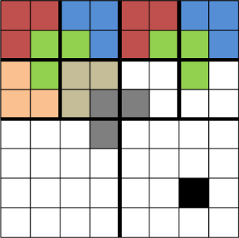
Tromino cover
Steps:
Divide the 2^{n} × 2^{n} board into 4 disjoint 2^{n−1} × 2^{n−1} subboards
Place a tromino at the center so that it fully covers one square from each of the three ( 3 ) subboards with no missing square, and misses the fourth subboard completely. This reduces the original problem into 4 smaller instances of the same problem!
Solve each smaller subproblem recursively using the same technique.
An algorithmic puzzle
Figure: Rezaul A. Chowdhury, CSE 373, 2014
17/44

Slide 22
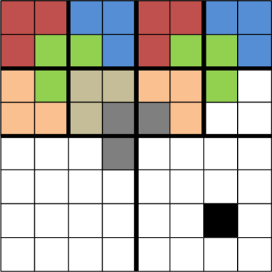
Tromino cover
Steps:
Divide the 2^{n} × 2^{n} board into 4 disjoint 2^{n−1} × 2^{n−1} subboards
Place a tromino at the center so that it fully covers one square from each of the three ( 3 ) subboards with no missing square, and misses the fourth subboard completely. This reduces the original problem into 4 smaller instances of the same problem!
Solve each smaller subproblem recursively using the same technique.
An algorithmic puzzle
Figure: Rezaul A. Chowdhury, CSE 373, 2014
18/44

Slide 23
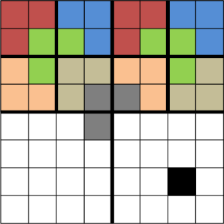
Tromino cover
Steps:
Divide the 2^{n} × 2^{n} board into 4 disjoint 2^{n−1} × 2^{n−1} subboards
Place a tromino at the center so that it fully covers one square from each of the three ( 3 ) subboards with no missing square, and misses the fourth subboard completely. This reduces the original problem into 4 smaller instances of the same problem!
Solve each smaller subproblem recursively using the same technique.
An algorithmic puzzle
Figure: Rezaul A. Chowdhury, CSE 373, 2014
19/44

Slide 24
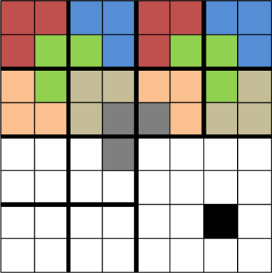
Tromino cover
Steps:
Divide the 2^{n} × 2^{n} board into 4 disjoint 2^{n−1} × 2^{n−1} subboards
Place a tromino at the center so that it fully covers one square from each of the three ( 3 ) subboards with no missing square, and misses the fourth subboard completely. This reduces the original problem into 4 smaller instances of the same problem!
Solve each smaller subproblem recursively using the same technique.
An algorithmic puzzle
Figure: Rezaul A. Chowdhury, CSE 373, 2014
20/44

Slide 25
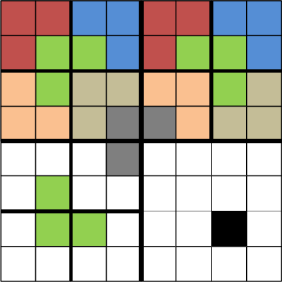
Tromino cover
Steps:
Divide the 2^{n} × 2^{n} board into 4 disjoint 2^{n−1} × 2^{n−1} subboards
Place a tromino at the center so that it fully covers one square from each of the three ( 3 ) subboards with no missing square, and misses the fourth subboard completely. This reduces the original problem into 4 smaller instances of the same problem!
Solve each smaller subproblem recursively using the same technique.
An algorithmic puzzle
Figure: Rezaul A. Chowdhury, CSE 373, 2014
21/44

Slide 26
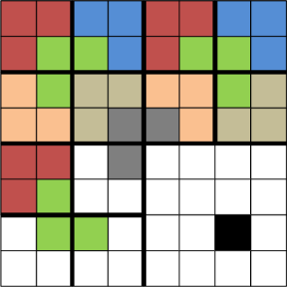
Tromino cover
Steps:
Divide the 2^{n} × 2^{n} board into 4 disjoint 2^{n−1} × 2^{n−1} subboards
Place a tromino at the center so that it fully covers one square from each of the three ( 3 ) subboards with no missing square, and misses the fourth subboard completely. This reduces the original problem into 4 smaller instances of the same problem!
Solve each smaller subproblem recursively using the same technique.
An algorithmic puzzle
Figure: Rezaul A. Chowdhury, CSE 373, 2014
22/44

Slide 27
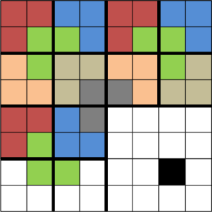
Tromino cover
Steps:
Divide the 2^{n} × 2^{n} board into 4 disjoint 2^{n−1} × 2^{n−1} subboards
Place a tromino at the center so that it fully covers one square from each of the three ( 3 ) subboards with no missing square, and misses the fourth subboard completely. This reduces the original problem into 4 smaller instances of the same problem!
Solve each smaller subproblem recursively using the same technique.
An algorithmic puzzle
Figure: Rezaul A. Chowdhury, CSE 373, 2014
23/44

Slide 28
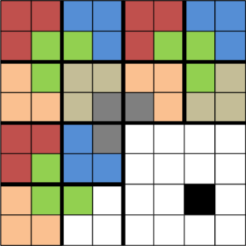
Tromino cover
Steps:
Divide the 2^{n} × 2^{n} board into 4 disjoint 2^{n−1} × 2^{n−1} subboards
Place a tromino at the center so that it fully covers one square from each of the three ( 3 ) subboards with no missing square, and misses the fourth subboard completely. This reduces the original problem into 4 smaller instances of the same problem!
Solve each smaller subproblem recursively using the same technique.
An algorithmic puzzle
Figure: Rezaul A. Chowdhury, CSE 373, 2014
24/44

Slide 29
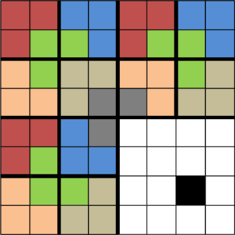
Tromino cover
Steps:
Divide the 2^{n} × 2^{n} board into 4 disjoint 2^{n−1} × 2^{n−1} subboards
Place a tromino at the center so that it fully covers one square from each of the three ( 3 ) subboards with no missing square, and misses the fourth subboard completely. This reduces the original problem into 4 smaller instances of the same problem!
Solve each smaller subproblem recursively using the same technique.
An algorithmic puzzle
Figure: Rezaul A. Chowdhury, CSE 373, 2014
25/44

Slide 30
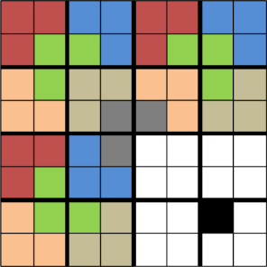
Tromino cover
Steps:
Divide the 2^{n} × 2^{n} board into 4 disjoint 2^{n−1} × 2^{n−1} subboards
Place a tromino at the center so that it fully covers one square from each of the three ( 3 ) subboards with no missing square, and misses the fourth subboard completely. This reduces the original problem into 4 smaller instances of the same problem!
Solve each smaller subproblem recursively using the same technique.
An algorithmic puzzle
Figure: Rezaul A. Chowdhury, CSE 373, 2014
26/44

Slide 31
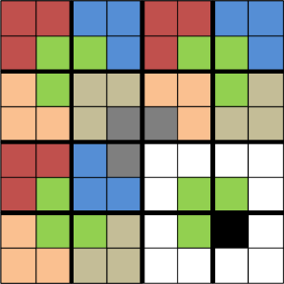
Tromino cover
Steps:
Divide the 2^{n} × 2^{n} board into 4 disjoint 2^{n−1} × 2^{n−1} subboards
Place a tromino at the center so that it fully covers one square from each of the three ( 3 ) subboards with no missing square, and misses the fourth subboard completely. This reduces the original problem into 4 smaller instances of the same problem!
Solve each smaller subproblem recursively using the same technique.
An algorithmic puzzle
Figure: Rezaul A. Chowdhury, CSE 373, 2014
27/44

Slide 32
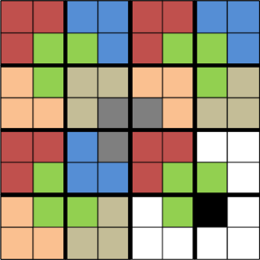
Tromino cover
Steps:
Divide the 2^{n} × 2^{n} board into 4 disjoint 2^{n−1} × 2^{n−1} subboards
Place a tromino at the center so that it fully covers one square from each of the three ( 3 ) subboards with no missing square, and misses the fourth subboard completely. This reduces the original problem into 4 smaller instances of the same problem!
Solve each smaller subproblem recursively using the same technique.
An algorithmic puzzle
Figure: Rezaul A. Chowdhury, CSE 373, 2014
28/44

Slide 33
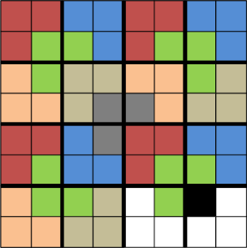
Tromino cover
Steps:
Divide the 2^{n} × 2^{n} board into 4 disjoint 2^{n−1} × 2^{n−1} subboards
Place a tromino at the center so that it fully covers one square from each of the three ( 3 ) subboards with no missing square, and misses the fourth subboard completely. This reduces the original problem into 4 smaller instances of the same problem!
Solve each smaller subproblem recursively using the same technique.
An algorithmic puzzle
Figure: Rezaul A. Chowdhury, CSE 373, 2014
29/44

Slide 34
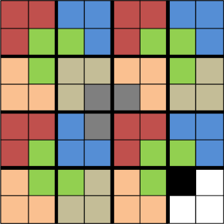
Tromino cover
Steps:
Divide the 2^{n} × 2^{n} board into 4 disjoint 2^{n−1} × 2^{n−1} subboards
Place a tromino at the center so that it fully covers one square from each of the three ( 3 ) subboards with no missing square, and misses the fourth subboard completely. This reduces the original problem into 4 smaller instances of the same problem!
Solve each smaller subproblem recursively using the same technique.
An algorithmic puzzle
Figure: Rezaul A. Chowdhury, CSE 373, 2014
30/44

Slide 35
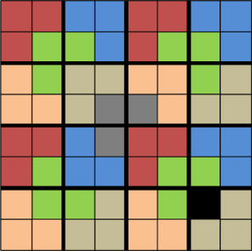
Tromino cover
Steps:
Divide the 2^{n} × 2^{n} board into 4 disjoint 2^{n−1} × 2^{n−1} subboards
Place a tromino at the center so that it fully covers one square from each of the three ( 3 ) subboards with no missing square, and misses the fourth subboard completely. This reduces the original problem into 4 smaller instances of the same problem!
Solve each smaller subproblem recursively using the same technique.
Figure: Rezaul A. Chowdhury, CSE 373, 2014
An algorithmic puzzle
31/44

Slide 36
What is Recursion
Every recursive definition has 2 parts:
BASE CASE(S): so simple that they can be solved directly
RECURSIVE CASE(S): make use of recursion to solve smaller subproblems and combine into a solution to the larger problem
____________________________________________________________________________|
Base Case: One or more conditions based on which
the function will stop the recursive call. (Stopping condition)
Recursive Case: The function calling itself within its definition.
Recursion

Slide 37
Recursion Has Two Phases
A recursive method first creates calls, then returns values/control.
1. Call phase
method(4)
2. Return phase
method(3)
method(4)
method(2)
method(3)
method(1)
method(2)
method(0) stops
Base case
method(1)
Input gets smaller / next
stops new calls
Previous calls begin returning one by one.
Recursion

Slide 38
Recursion vs. While Loop
🔁 Recursion vs. While Loop
Recursion is often an alternative to a while loop.
You usually don’t use recursion and a while loop together
— they solve the same kind of problems.
Shortcut process
Loop Concept | Recursion Equivalent
Loop condition | Opposite becomes base case
Loop body | Recursive case
Recursion

Slide 39
How to convert a loop into recursion
Use the same changing variable as a parameter; stop with a base case.
Iterative structure
Recursive structure
int i = start;
while (condition) {
work(i);
update i;
}
method(i) {
if (base case)
return;
work(i);
method(updated i);
}
loop controlling variable becomes parameter
Same result, different control flow
Recursion creates method calls
initialize
condition
update
show(1)
show(2)
show(3)
Base case stops the chain;
return unwinds it.

Slide 40
Example 01: Print 1 to 4
Recursive call moves forward by increasing i.
Iterative Java
Recursive Java
public static void show1to4While() {
int i = 1;
while (i <= 4) {
System.out.println(i);
i++;
}
}
public static void show1to4Rec(int i) {
if (i > 4) {
return;
}
System.out.println(i);
show1to4Rec(i + 1);
}
Output
Print before recursive call → output appears immediately.
1
2
3
4
Output
Call stack
1
2
3
4
show(1) (Call from main method)
main(){
……
show(1)
……
}
show(2)
show(3)
show(4)
show(5) (Base case) stops

Slide 41
Example 02: Print 4 to 1
Use decrementing i, or print after the recursive call to reverse order.
Iterative Java
Recursive Java
public static void show4to1While() {
int i = 4;
while (i > 0) {
System.out.println(i);
i--;
}
}
public static void show4to1Rec(int i) {
if (i == 0) {
return;
}
System.out.println(i);
show4to1Rec(i - 1);
}
Print before recursive call → output appears immediately.
Output
4
3
2
1
Output
4
3
2
1
Call stack
show(4) (Call from main method)
show(4 - 1 = 3)
main(){
……
show(4)
……
}
show(3 - 1 = 2)
show(2 - 1 = 1)
show(1 - 1 = 0) (Base case) stops

Slide 42
Example 02: Print 4 to 1
Use decrementing i, or print after the recursive call to reverse order.
Iterative Java
Recursive Java
public static void show4to1While() {
int i = 4;
while (i > 0) {
System.out.println(i);
i--;
}
}
public static void show4to1Rec(int i) {
if (i == 0) {
return;
}
System.out.println(i);
show4to1Rec(i - 1);
}
Order-change idea
// From i = 1 to 4, print after the call
show4to1Reverse(i + 1);
System.out.println(i);
Output
4
3
2
1
After the base case returns,
the previous recursive calls begin returning one by one.

Slide 43
Example 02: Change Recursive call order (Print 4 to 1)
Change Recursive call order to get the backward print
After the base case returns, the previous recursive calls begin returning one by one.
Print before recursive call → forward order.
Print after recursive call → reverse/bakward order.
public static void show4to1Rec(int i) {
if (i == 0) {
return;
}
System.out.println(i);
show4to1Rec(i - 1);
}
public static void show4to1Rec(int i) {
if (i == 0) {
return;
}
show4to1Rec(i - 1);
System.out.println(i);
}
Output
Output
Call stack
Call stack
4
3
2
1
show(4) (Call from main method)
1
2
3
4
show(4) (Call from main method)
show(4 - 1 = 3)
main(){
……
show(4)
……
}
show(4 - 1 = 3)
show(3 - 1 = 2)
show(3 - 1 = 2)
show(2 - 1 = 1)
show(2 - 1 = 1)
show(1 - 1 = 0) (Base case) stops
show(1 - 1 = 0) (Base case) stops

Slide 44
Shortcut Rule for Recursion
The position of the work decides the output order.
Rule 1
Rule 2
Work Before Recursive Call
Work After Recursive Call
Order inside the method:
Order inside the method:
1. Perform the work
2. Make the recursive call
1. Make the recursive call
2. Perform the work
work;
methodCall();
methodCall();
work;
Result: Forward / original order
Result: Backward / reverse order
Example output: 1 2 3 4
Example output: 4 3 2 1
Easy reminder: Work before call → Forward | Work after call → Reverse

Slide 45
Example 03: Sum from 1 to N (version 1)
The recursive method returns current value + result of the remaining range.
Iterative Java
Recursive Java
public static int sum1toNWhile(int n) {
int sum = 0;
int i = 1;
while (i <= n) {
sum += i;
i++;
}
return sum;
}
public static int sum1toNRec(int i, int n) {
if (i > n) {
return 0;
}
return i + sum1toNRec(i + 1, n);
}
Call stack
Result = 15
Sum(5) = 1 + 2 + 3 + 4 + 5 + 0 = 15
sum(1,5)
sum(1,5) = 1 + sum(2,5) = 1 + 14 = 15
main(){
……
sum(1, 5)
……
}
sum(2,5)
sum(2,5) = 2 + sum(3,5) = 2 + 12 = 14
sum(3,5)
sum(3,5) = 3 + sum(4,5) = 3 + 9 = 12
sum(4,5)
sum(4,5) = 4 + sum(5,5) = 4 + 5 = 9
sum(5,5)
sum(5,5) = 5 + sum(6, 5) = 5 + 0 = 5
sum(6,5)
sum(6,5) = 0 (Base case)

Slide 46
public static int sum1toNRec(int i, int n) {
if (i > n) {
return 0;
}
return i + sum1toNRec(i + 1, n);
}
Example 03: Sum from 1 to N (v1)
1. Call phase: go down
2. Return phase: come back up
sum(1,5) = 1 + sum(2,5)
sum(6,5) = 0
sum(2,5) = 2 + sum(3,5)
sum(5,5) = 5 + 0 = 5
sum(3,5) = 3 + sum(4,5)
sum(4,5) = 4 + 5 = 9
sum(4,5) = 4 + sum(5,5)
sum(3,5) = 3 + 9 = 12
sum(5,5) = 5 + sum(6,5)
sum(2,5) = 2 + 12 = 14
sum(6,5) = 0 Base case
calls
returns
sum(1,5) = 1 + 14 = 15
Important: no addition is finalized during the call phase. The final result is built during the return phase.
Final answer: sum1toNRec(1, 5) = 15

Slide 47
Example 03: Sum from 1 to N (version 2)
The recursive method returns current value + result of the remaining range.
Iterative Java
Recursive Java
public static int sum1toNWhile(int n) {
int sum = 0;
int i = 1;
while (i <= n) {
sum += i;
i++;
}
return sum;
}
public static int sum1toNRec(int i, int n) {
if (i == n) {
return n;
}
return i + sum1toNRec(i + 1, n);
}
Call stack
Sum(5) = 1 + 2 + 3 + 4 + 5 = 15
sum(1,5)
sum(1,5) = 1 + sum(2,5) = 1 + 14 = 15
sum(2,5)
sum(2,5) = 2 + sum(3,5) = 2 + 12 = 14
main(){
……
sum(1, 5)
……
}
sum(3,5)
sum(3,5) = 3 + sum(4,5) = 3 + 9 = 12
sum(4,5)
sum(4,5) = 4 + sum(5,5) = 4 + 5 = 9
sum(5,5)
sum(5,5) = 5 (Base case)
Result = 15

Slide 48
Example 03: Sum from 1 to N (version 2)
The recursive method returns current value + result of the remaining range.
Recursive Java
Call phase: go down
Return phase:
add while coming back
public static int sum1toNRec(int i, int n) {
if (i == n) {
return n;
}
return i + sum1toNRec(i + 1, n);
}
sum(1,5) = 1 + sum(2,5)
1 + 14 = 15
sum(2,5) = 2 + sum(3,5)
2 + 12 = 14
sum(3,5) = 3 + sum(4,5)
3 + 9 = 12
sum(4,5) = 4 + sum(5,5)
4 + 5 = 9
sum(5,5) = 5 Base case
5
Sum(5) = 1 + 2 + 3 + 4 + 5 = 15
Base case returns first; the final answer is completed during the return phase.

Slide 49
Example 04: Factorial
1
n * (n-1)!
if n = 0
if n > 0
n! =
5! = 5*4*3*2*1
4! = 4*3*2*1
3! = 3*2*1
2! = 2*1
1! = 1
0! = 1
5! = 5*4!
4! = 4*3!
3! = 3*2!
2! = 2*1!
1! = 1*0!
0! = 1
Recursion

Slide 50
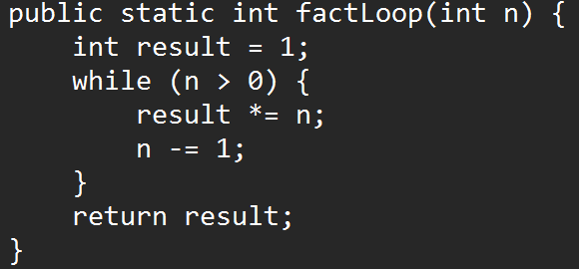
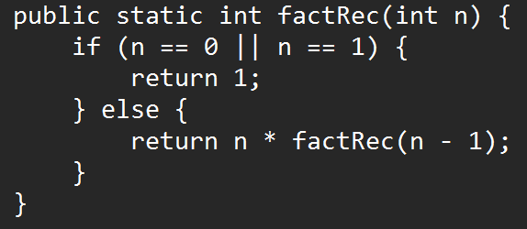
Example 04: Factorial
1
n * (n-1)!
if n = 0
if n > 0
n! =
Iterative
Recursive
Recursion

Slide 51
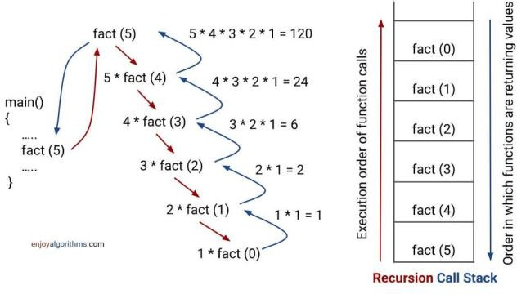
Example 04: Factorial
1
n* (n-1)!
if n = 0
if n > 0
n! =
Recursive
Sourse; https://www.enjoyalgorithms.com/blog/recursion-explained-how-recursion-works-in-programming
Recursion

Slide 52
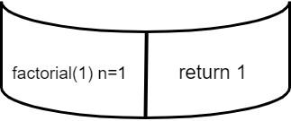
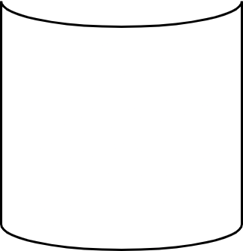
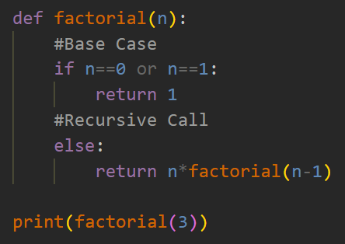
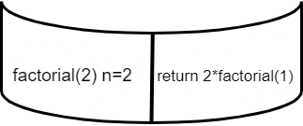
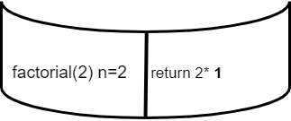
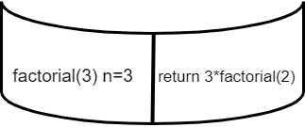
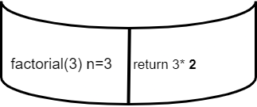
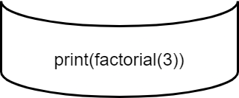
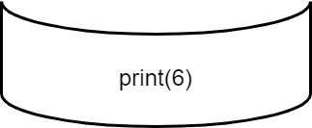
Example 04: Factorial Call stack example
Output: 6

Slide 53
Example 04: Factorial
Multiplicative identity is 1; base case is 0! or 1!.
Iterative Java
Recursive Java
public static int factLoop(int n) {
int result = 1;
while (n > 0) {
result *= n;
n--;
}
return result;
}
public static int factRec(int n) {
if (n == 0 || n == 1) {
return 1;
}
return n * factRec(n - 1);
}
fact(4)
Call stack
main(){
……
fact(4)
……
}
fact(4) (Call from main method)
= 4 × fact(3)
fact(4 - 1 = 3)
= 4 × 3 × fact(2)
= 4 × 3 × 2 × fact(1)
fact(3 - 1 = 2)
= 24
fact(2 - 1 = 1) (Base case) stops

Slide 54
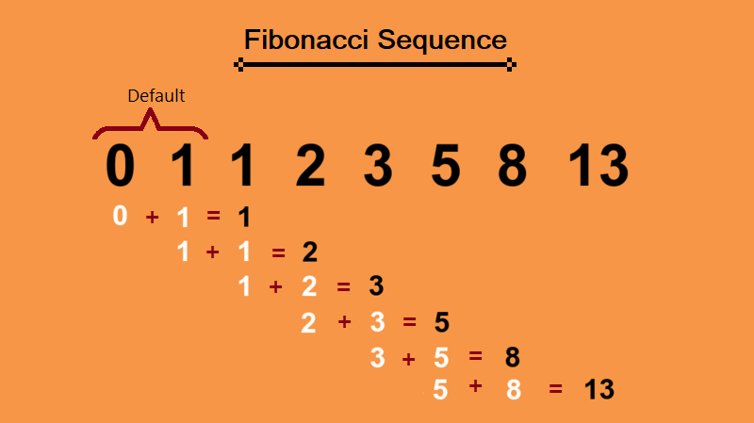
Example 05: Nth Fibonacci number
Iterative version stores previous two values; recursive version branches into two calls.
^{Fib(n) =}
0 if n = 0
1 if n = 1
(Base case)
(Base case)
(Recursive case)
Recursive Function
Fib(n–1) + Fib(n–2) if n > 1
Recursion

Slide 55
Example 05: Nth Fibonacci number
Iterative version stores previous two values; recursive version branches into two calls.
Iterative Java
Recursive Java
public static int getNthFibonacci(int n) {
if (n == 0) return 0;
if (n == 1) return 1;
int n1 = 0, n2 = 1, fibSum = 0;
for (int i = 2; i <= n; i++) {
fibSum = n1 + n2;
n1 = n2;
n2 = fibSum;
}
return n2;
}
public static int getNthFibonacciRec(int n) {
if (n == 0) return 0;
if (n == 1) return 1;
return getNthFibonacciRec(n - 1)
+ getNthFibonacciRec(n - 2);
}
F(4)
Examples
F(3)
F(2)
F(4)=3
F(6)=8
F(8)=21
F(2)
F(1)
F(1)
F(0)
F(1)
F(0)

Slide 56
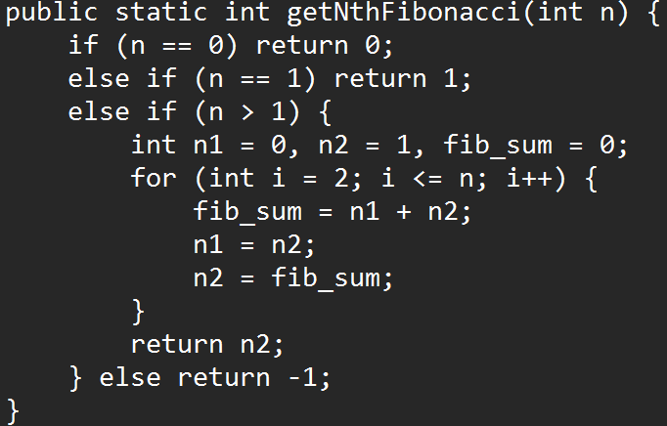
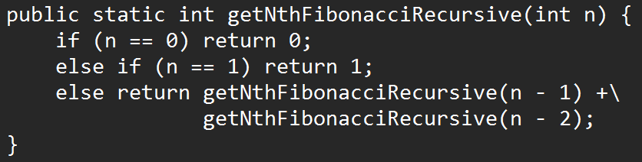
Example 05: Nth Fibonacci number
^{Fib(n) =}
0 if n = 0
1 if n = 1
Fib(n–1) + Fib(n–2) if n > 1
Iterative
Recursive
Recursion

Slide 57
Fibonacci: Visualize the Branching (Recursion Tree)
Recursive Fibonacci creates two calls and repeats the same subproblems.
fib(n) = fib(n-1) + fib(n-2)
F(5)
F(4)
F(3)
Repeated subproblems
F(3)
F(2)
F(2)
F(1)
F(2)
F(1)
F(1)
F(0)
F(1)
F(0)
F(3) and F(2) are calculated more than once.
This is why memoization is useful later.
F(1)
F(0)

Slide 58
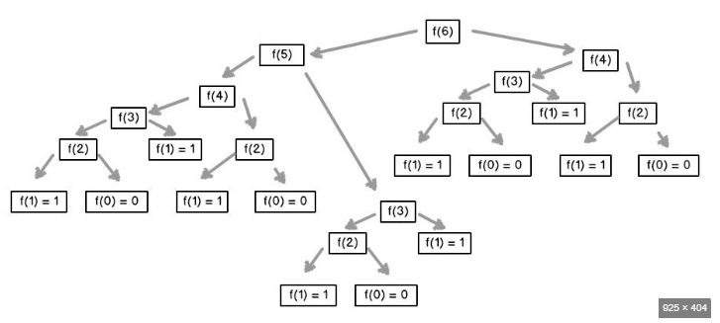
Fibonacci: Visualize the Branching (Recursion Tree)
Recursive Fibonacci creates two calls and repeats the same subproblems.
fib(n) = fib(n-1) + fib(n-2)
Source: https://www.idc-online.com/technical_references/pdfs/information_technology/Tree_Recursion_in_Python.pdf

Slide 59
Recursion on Arrays
The index moves just like a loop counter.
sample array
0
1
2
3
4
5
6
7
12
44
6
57
69
87
5
3
i is the recursive parameter

Slide 60
Example 06: Print array forward
Base case: stop when i reaches arr.length.
Iterative Java
Recursive Java
public static void printArrayForwardWhile(int[] arr) {
int i = 0;
while (i < arr.length) {
System.out.print(arr[i] + " ");
i++;
}
System.out.println();
}
public static void printArrayForwardRec(int i, int[] arr) {
if (i == arr.length) {
return;
}
System.out.print(arr[i] + " ");
printArrayForwardRec(i + 1, arr);
}
0
1
2
3
Call stack
12
44
6
57
main(){
……
method(0, arr)
……
}
method (0, arr) (Call from main method)
method (1, arr)
i + 1
method (2, arr)
Output
method (3, arr)
12
44
6
57
method (4, arr) (Base case—out of bounds–returns Null)

Slide 61
Example 07: Print array backward
Start from last index and move toward 0.
Iterative Java
Recursive Java
public static void printArrayBackwardWhile(int[] arr) {
int i = arr.length - 1;
while (i >= 0) {
System.out.print(arr[i] + " ");
i--;
}
System.out.println();
}
public static void printArrayBackwardRec(int i, int[] arr) {
if (i < 0) {
return;
}
System.out.print(arr[i] + " ");
printArrayBackwardRec(i - 1, arr);
}
i starts at last index and decreases
Call stack
0
1
2
3
method (3, arr) (Call from main method)
12
44
6
57
main(){
……
method(3, arr)
……
}
method (2, arr)
i - 1
method (1, arr)
Output
method (0, arr)
57
6
44
12
method (-1, arr) (Base case—out of bounds–returns Null)

Slide 62
Example 07: Print array backward
After the base case returns,
the previous recursive calls begin returning one by one.
Print Forward (Work happens before the recursive call)
Print Backward (Work happens After the recursive call)
public static void printArrayForwardRec(int i, int[] arr) {
if (i == arr.length) {
return;
}
System.out.print(arr[i] + " ");
printArrayForwardRec(i + 1, arr);
}
public static void printArrayForwardRec(int i, int[] arr) {
if (i == arr.length) {
return;
}
printArrayForwardRec(i + 1, arr);
System.out.print(arr[i] + " ");
}
Output
0
1
2
3
Call stack
57
6
44
12
12
44
6
57
method (0, arr) (Call from main method)
method (1, arr)
main(){
……
method(0, arr)
……
}
i + 1
method (2, arr)
method (3, arr)
method (4, arr) (Base case—out of bounds–returns Null)

Slide 63
Example 08: Sum of array elements
Recursive version adds arr[i] to the sum of the rest.
Iterative Java
Recursive Java
public static int arrSumIterative(int[] arr) {
int total = 0;
int i = 0;
while (i < arr.length) {
total += arr[i];
i++;
}
return total;
}
public static int arrSumRec(int i, int[] arr) {
if (i == arr.length) {
return 0;
}
return arr[i] + arrSumRec(i + 1, arr);
}
main(){
……
arrSum(0, arr)
……
}
arrSum(0) = 10 + arrSum(1)= 10 + 50 = 60
Example: total = 60
arrSum(1) = 20 + arrSum(2) = 20 + 30 = 50
Given array, arr:
0
1
2
arrSum(2) = 30 + arrSum(3) = 30 + 0 = 30
10
20
30
arrSum(3) = 0 (Base case—out of bounds)
Result = 60

Slide 64
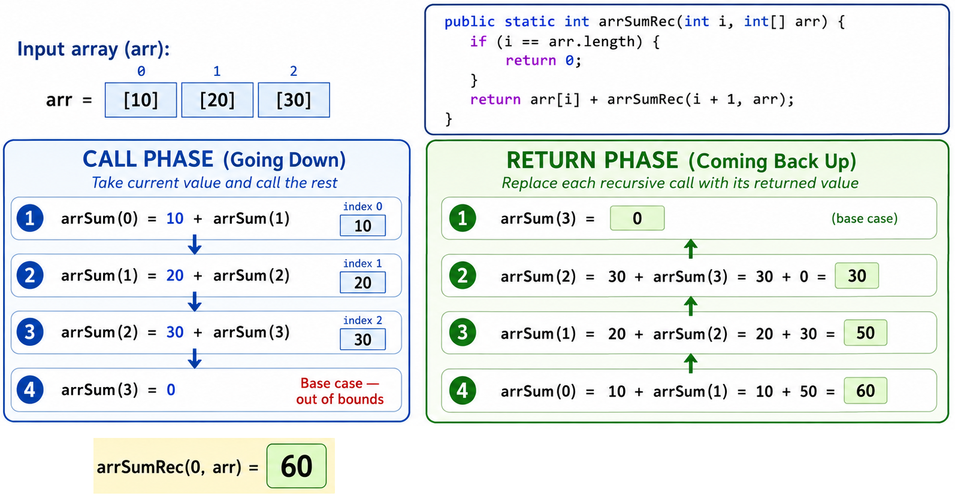
Example 08: Sum of array elements

Slide 65
Example 09: Add even, subtract odd
Use a helper method to convert each element into +n or −n.
Iterative Java
Recursive Java
public static int weirdSumLoop(int[] arr) {
int total = 0;
int i = 0;
while (i < arr.length) {
total += evenOdd(arr[i]);
i++;
}
return total;
}
// odd -> -n, even -> +n (Helper method)
public static int evenOdd(int n) {
if (n % 2 == 1) return -n;
return n;
}
public static int weirdSumRec(int i, int[] arr) {
if (i == arr.length) return 0;
return evenOdd(arr[i])+ weirdSumRec(i + 1, arr);
}
// odd -> -n, even -> +n (Non-recursive Helper method)
public static int evenOdd(int n) {
if (n % 2 == 1) return -n;
return n;
}
−1 + 4 + 6 − 5 − 9 + 2 = −3
Example array
Odd numbers become negative;
even numbers remain positive.
0
1
2
3
4
5
1
4
6
5
9
2

Slide 66
Example 10: Multiplication of array elements
Recursive multiplication uses 1 as the base return value.
Iterative Java
Recursive Java
public static int arrMulIterative(int[] arr) {
int mulAns = 1;
int i = 0;
while (i < arr.length) {
mulAns *= arr[i];
i++;
}
return mulAns;
}
public static int arrMulRec(int i, int[] arr) {
if (i == arr.length) {
return 1;
}
return arr[i] * arrMulRec(i + 1, arr);
}
Example: product = 144
0
1
2
3
3 × 4 × 6 × 2 = 144
Given array, arr:
3
4
6
2
Base return value is 1
because multiplying by 1 changes nothing.

Slide 67
Recursion on Linked Lists
The node reference moves like an index: temp = temp.next.
sample linked list
10
20
30
40
50
null
temp.next is the recursive move

Slide 68
Example 11: Print linked list forward
Loop moves temp = temp.next; recursion passes temp.next.
Iterative Java
Recursive Java
public static void printLLIterative(Node head) {
Node temp = head;
while (temp != null) {
System.out.print(temp.elem + " -> ");
temp = temp.next;
}
System.out.println("null");
}
public static void printForwardRec(Node temp) {
if (temp == null) {
System.out.println("null");
return;
}
System.out.print(temp.elem + " => ");
printForwardRec(temp.next);
}
Work happens before the recursive call.
traversal order
Call stack
main(){
……
FWPrint(head)
……
}
10
20
30
10 (Call from main method)
null
20
Output
30
10
20
30
null
null (Base case_returns Null)

Slide 69
Example 12: Print linked list backward
Change Recursive call order to get the backward print
After the base case returns, the previous recursive calls begin returning one by one.
Print before recursive call → forward order.
Print after recursive call → reverse/bakward order.
public static void printForwardRec(Node temp) {
if (temp == null) {
System.out.println("null");
return;
}
System.out.print(temp.elem + " => ");
printForwardRec(temp.next);
}
public static void printBackwardRec(Node temp) {
if (temp == null) {
return;
}
printBackwardRec(temp.next);
System.out.print(temp.elem + " <= ");
}
Work happens before the recursive call.
Work happens After the recursive call.
Given linked list
main(){
……
BWPrint(head)
……
}
Call stack
10
20
30
null
10 (Call from main method)
20
Output
30
30
20
10
null (Base case_returns Null)

Slide 70
Example 13: Print linked list backward
Change Recursive call order to get the backward print
After the base case returns, the previous recursive calls begin returning one by one.
Given linked list
10
20
30
null
Call phase:
no output yet
Return phase:
print now
public static void printBackwardRec(Node temp) {
if (temp == null) {
return;
}
printBackwardRec(temp.next);
System.out.print(temp.elem + " <= ");
}
print(10)
print(20)
10 <=
print(30)
20 <=
print(null) stops
30 <=
Output: 30 <= 20 <= 10 <=
Key idea: print before call → forward order; print after call → backward order.

Slide 71
Example 13: Convert array to linked list
Create the first node, then connect each next node. Recursive version returns the current node.
Node class
Iterative Java
Recursive Java
static class Node {
int elem;
Node next;
Node(int elem) {
this.elem = elem;
this.next = null;
}
}
public static Node arr2LL(int[] arr) {
if (arr.length == 0) return null;
Node head = new Node(arr[0]);
Node current = head;
int i = 1;
while (i < arr.length) {
Node newNode = new Node(arr[i]);
current.next = newNode;
current = current.next;
i++;
}
return head;
}
public static Node arr2LL(int[] arr, int i) {
if (i == arr.length) {
return null;
}
Node current = new Node(arr[i]);
current.next = arr2LL(arr, i + 1);
return current;
}
main(){
……
arr2LL(arr, 0)
……
}
Call stack
arr2LL(arr, 0) (Call from main method)
array
10→arr2LL(arr, 1)
0
1
2
3
created list
20→arr2LL(arr, 2)
10
20
30
40
10
20
30
40
null
30→arr2LL(arr, 3)
40→arr2LL(arr, 4) (Base case_returns Null)

Slide 72
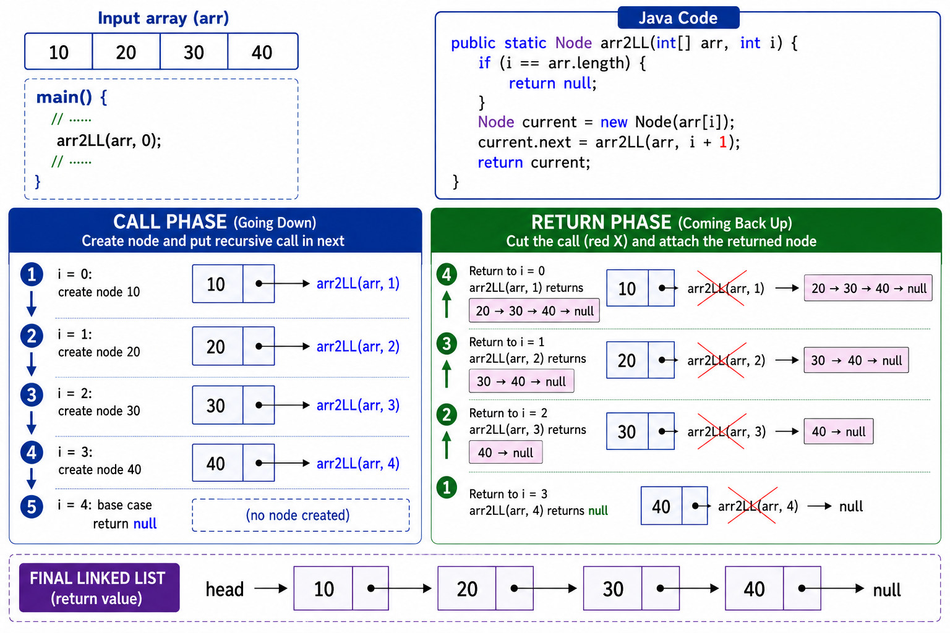
Example 13: Convert array to linked list

Slide 73
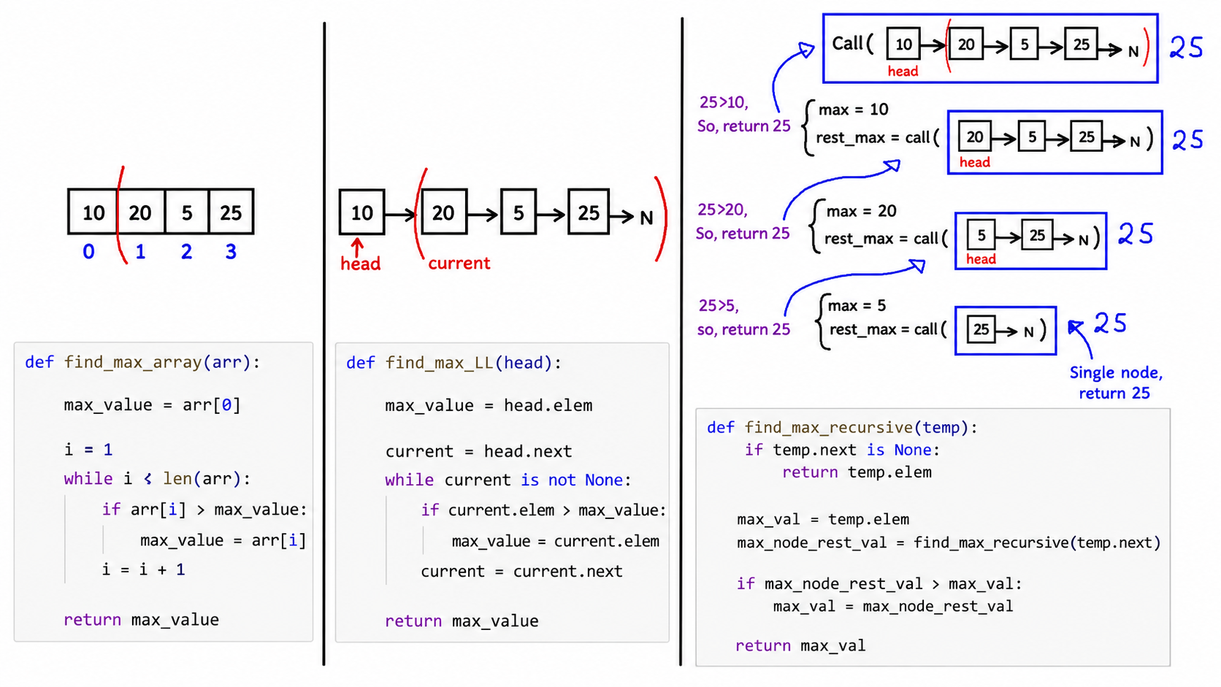
Example 14: Find maximum in linked list
Recursive version compares current node with maximum from the rest.
main(){
……
method(head)
……
}

Slide 74
Example 14: Find maximum in linked list
Recursive version compares current node with maximum from the rest.
Iterative Java
Recursive Java
public static Integer findMaxIterative(Node head) {
if (head == null) return null;
int maxValue = head.elem;
Node current = head.next;
while (current != null) {
if (current.elem > maxValue) {
maxValue = current.elem;
}
current = current.next;
}
return maxValue;
}
public static int findMaxRec(Node temp) {
if (temp.next == null) {
return temp.elem;
}
int maxRest = findMaxRec(temp.next);
if (maxRest > temp.elem) {
return maxRest;
}
return temp.elem;
}
max(3) = 3 (Tail is the base case)
Example list
max(25, 3) = 25
max(5, 25) = 25
10
20
5
25
3
null
max(20, 25) = 25
max(10, 25) = 25

Slide 75
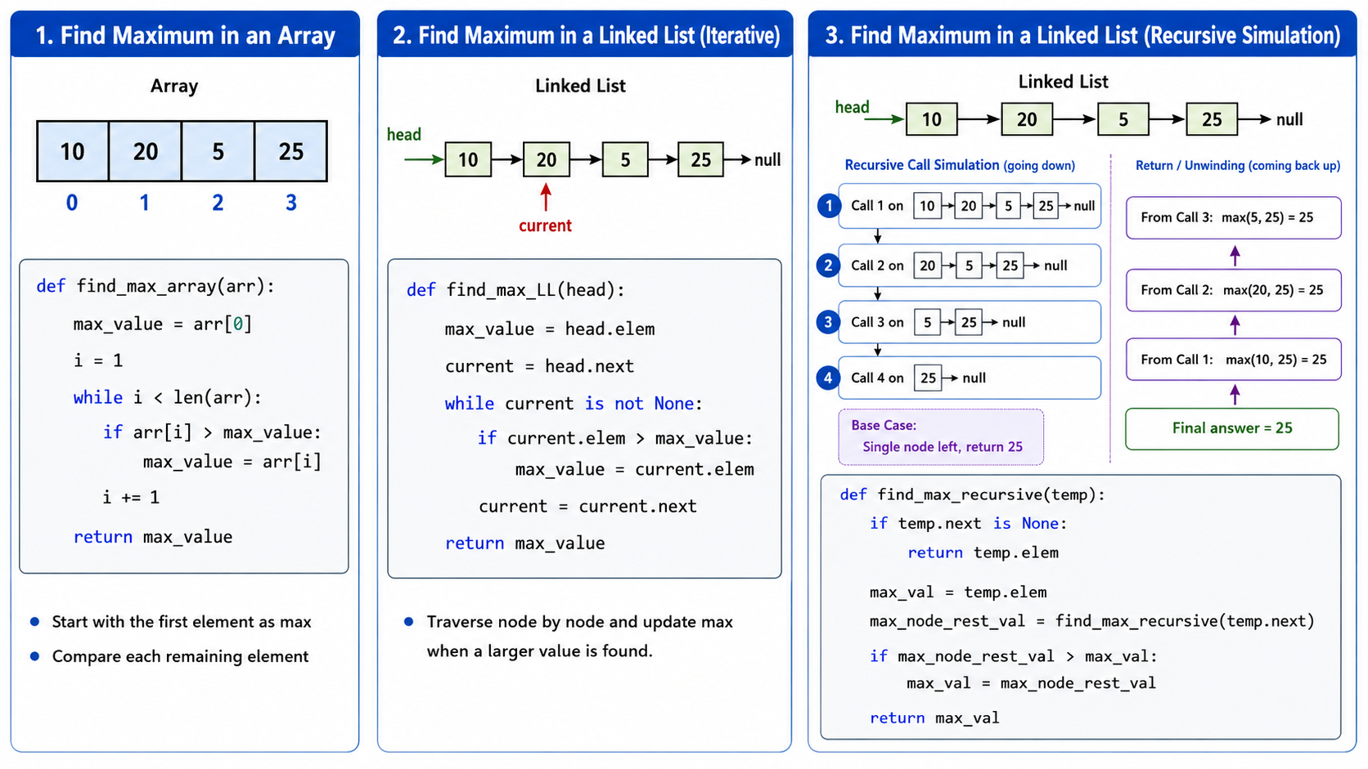

Slide 76
Example 14: Find maximum in linked list
Recursive version compares current node with maximum from the rest.

Slide 77
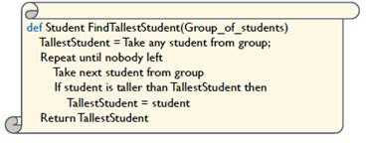
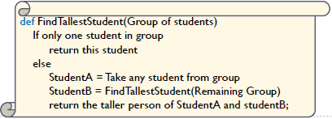
Example 15: Find the tallest person in a group of N > 0 students
Iterative
Recursive
Recursion

Slide 78
Recursion checklist
Before writing recursive Java code, identify these three parts.
1
Base case
The stopping condition that prevents infinite calls.
2
Recursive case
The method calls itself using a smaller or simpler input.
3
Work order
Perform the work before the recursive call for forward order.
Perform the work after the recursive call for reverse order.
Note: For recursive methods that return a value, choose an appropriate base-case return value:
0 for addition
1 for multiplication
null for the end of linked-list construction
might return a value

Slide 79
References
Brad Miller and David Ranum, Problem Solving with Algorithms and Data Structures, Release 3, 2013
Object Oriented Programming

